Slide 1
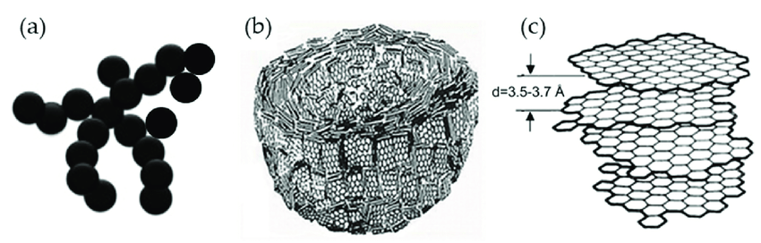
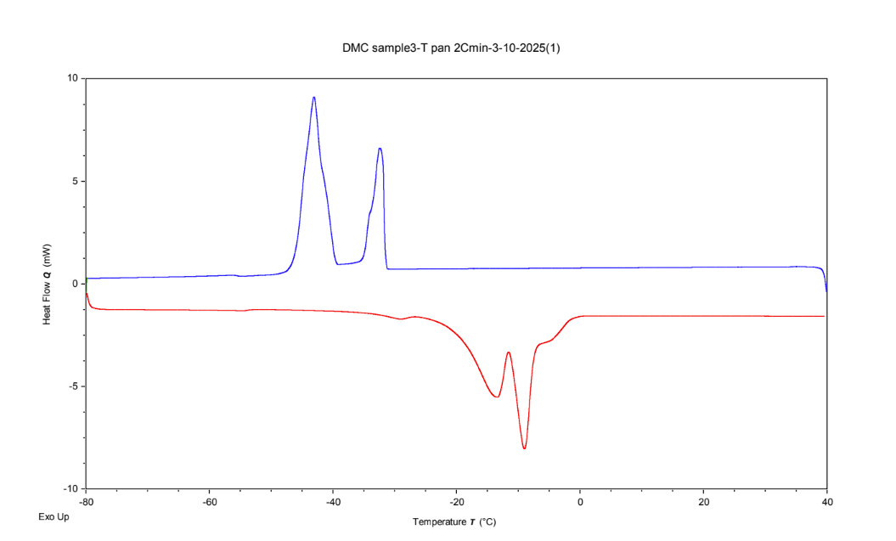
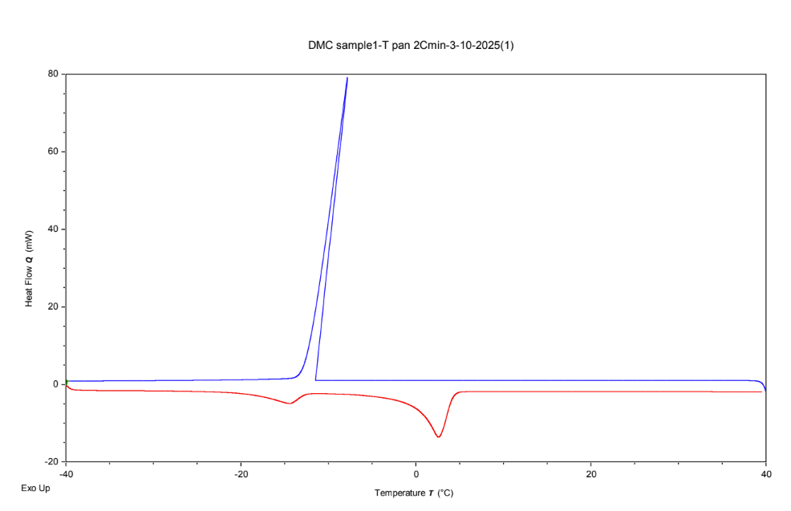
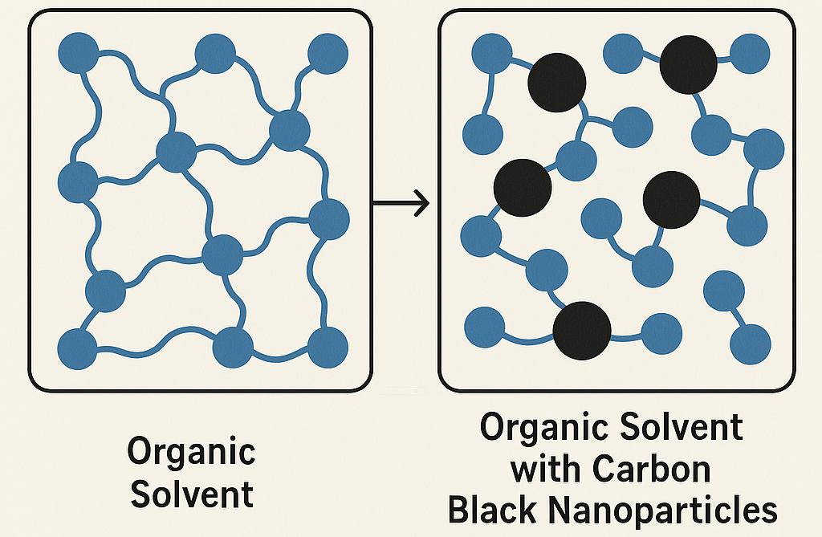


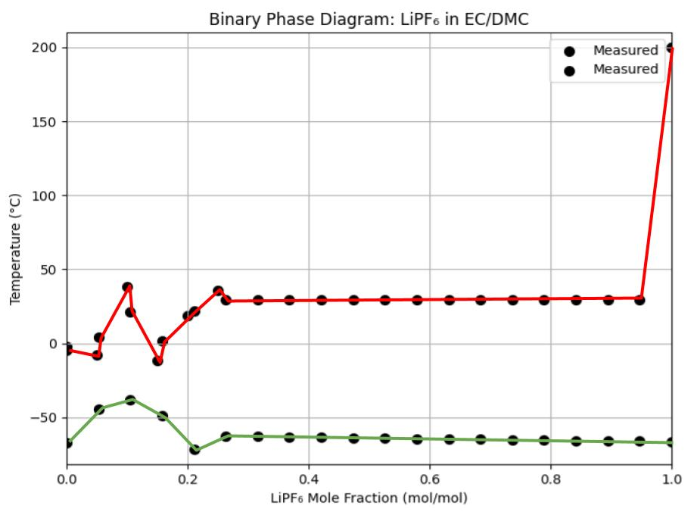
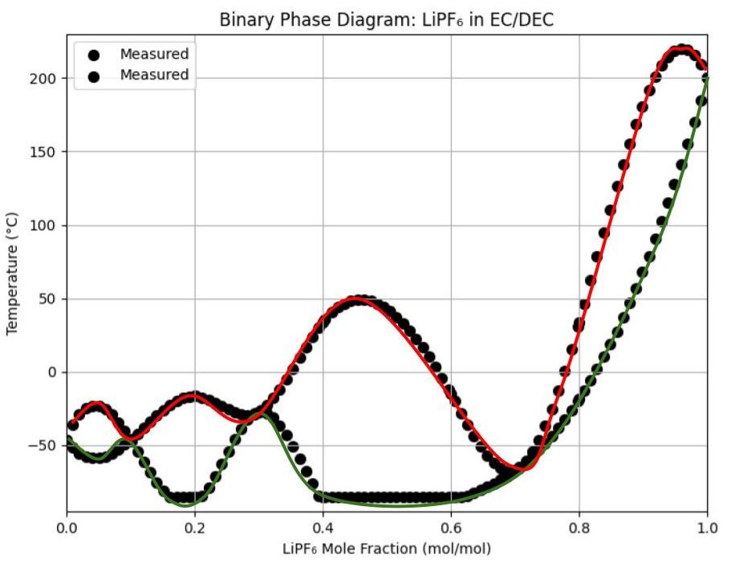
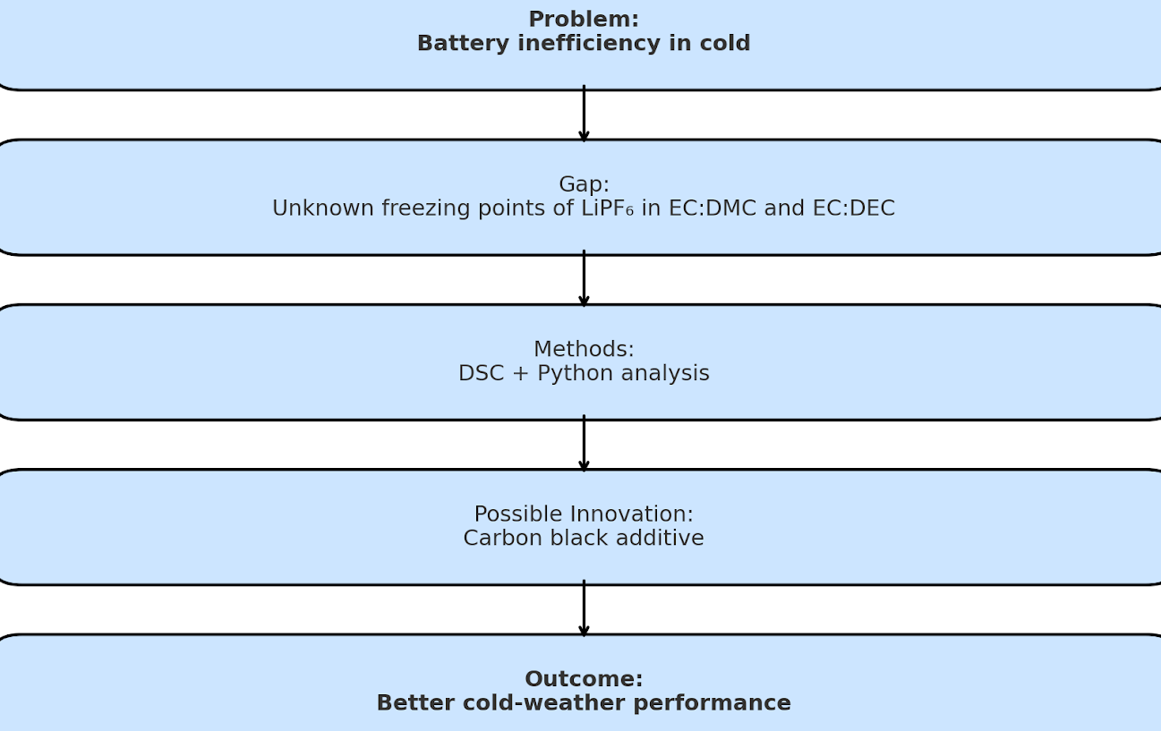
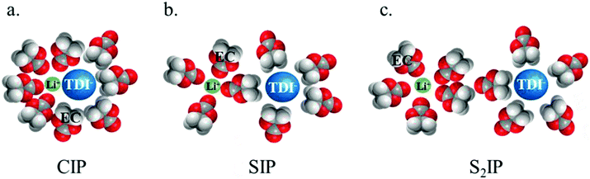
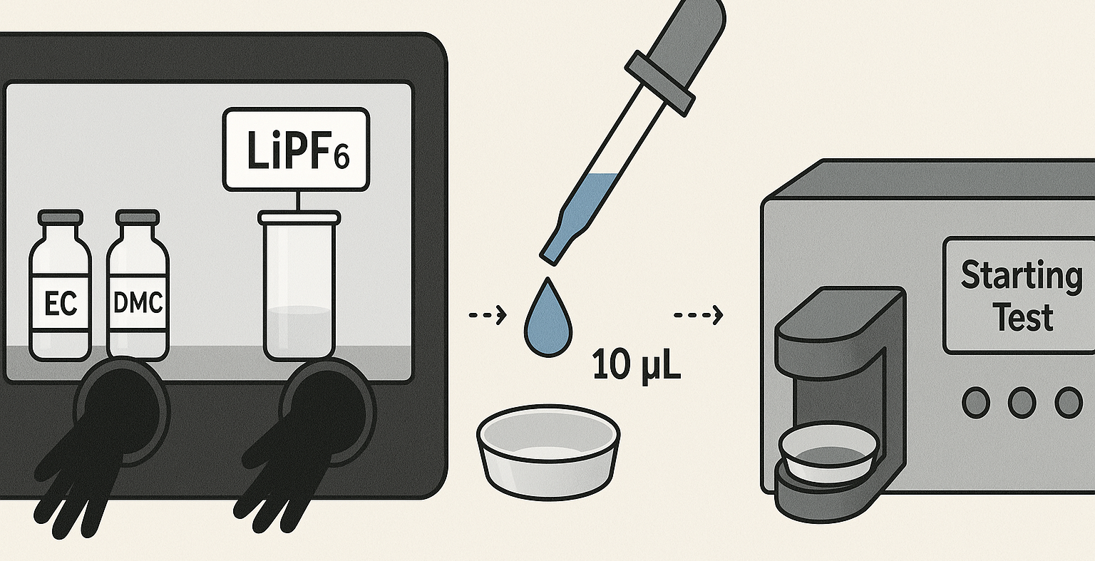
Analyzing the Phase Transition of a Liquid Electrolyte at Low Temperatures
Why Carbon Black?
Sample Differential Scanning Calorimetry Results
(1)
Above: LiPF6 in EC/DEC, the left two and right two graphs represent the same molar ratios of LiPF6:EC:DEC respectively
Jalaj Mehta, Xiaohan Chen, Yuan Yang
Materials Science and Engineering Department, Yang Lab
Correspondence: jsm2265@columbia.edu
Carbon black has conductive properties due to its structure, and can exist as nanoparticle sin solution that disrupt the formation of crystalline solid structures
Highlights
The liquid electrolytes present in electrochemical form more precipitates and eventually undergo phase changes in extremely cold climates
There are sparse phase diagrams representative of organic solvents and lithium that nexus to form liquid electrolytes in Li-ion batteries
Carbon-black is an electrically conductive additive that may be able to change the colligative properties of a solvent, like it’s freezing point, without significantly affecting the efficiency of the liquid electrolyte system
Methods
Differential Scanning Calorimetry to determine the phase transition points of ranges of sample compositions
Auto-identification and plotting of phase transition points via changes in first and second derivatives
Glove-box sample preparation using massing ratios of ethyl carbonate, lithium hexafluorophosphate, and dimethyl carbonate
Usage of __ prediction method to develop prospective curves for LiPF6:EC:DEC
Above: LiPF6 in EC/DEC with carbon black(GXC-16) additives; Curves shifted to the left indicate freezing point depression
Binary Phase Diagrams
Left:
Binary phase diagrams of LiPF6 in EC/DMC (left) and LiPF6 in EC/DEC (right)
Relevant Programming Methods
Machine Learning based extrapolation
k-NN (nearest-neighbor) regression
Sklearn Python Polynomial-based Interpolation
Aggregation of data points via temperature tolerance
The two lines represent two different solidus curves, of which two exist due to supercooling mechanisms
Abstract
Right:
Interaction between Ethyl Carbonate, Lithium cations, PF6 anions, and Dimethyl Carbonate
Differential Scanning Calorimetry Procedure
Melt EC and DMC so that a solution can be formed, requires light heating on hot plate over 30 minutes
Measure out samples by mass using the molar ratios as conversion rates
Mix LiPF6. EC, and DMC into single vial and remove from glovebox
Pre-mass T-Zero aluminum hermetic pan and then add 6-10 uL of sample and quickly seal
Mass sample after sealing and subtract mass of pan pre-seal to determine pre-test mass of solution
Run differential scanning calorimetry protocol, ensure sample and reference pan masses are correct
After protocol is finished remove sample and re-mass to ensure there was no mass loss during the procedure
Carbon Black seems to cause freezing point depression in organic solvents
Once LiPF6 hit its solubility limit in organic solvents the phase diagrams tend to either go astray or completely flatten out
This works serves as the precursor for further DSC studies of Lithium in organic electrolytes, providing:
1) A concrete testing methodology and regime 2) An efficient and thorough data analysis program
3) Insights into the solidus curves of binary phase diagrams 4) The beginnings of relevant ternary phase diagrams

